Slide 1
Philips / Databricks
T-Sql Migration Workshop
Hari Gopinath
Sr. Solutions Consultant

Slide 2
Agenda
Just enough python for Pyspark
User Defined Functions (UDFs)
T-SQL vs pyspark
Pyspark coding challenge
T-sql migration example
Delta Live table solution
Bring your own use case
Best practices

Slide 3
Python

Slide 4
“Python is an interpreted, object-oriented, high-level programming language with dynamic semantics. Its high-level built in data structures, combined with dynamic typing and dynamic binding, make it very attractive for Rapid Application Development, as well as for use as a scripting or glue language to connect existing components together.”
https://www.python.org/doc/essays/blurb

Slide 5
What is Python?
Python is an interpreted programming language (compilation of the program is not required)
The main focus is on readability and productivity
It is dynamically typed language (type checking is performed at run time)
Despite their dynamic nature, values cannot be implicitly coerced to unrelated types (for example, print("Foo " + 5) throws a TypeError)
Created by Guido van Rossum and first released in 1990

Slide 6
Python & Databricks
Databricks provides a notebook interface for developing executable code, visualizations, and narrative text. When you run an executable code cell in a notebook, the code is executed in a Python REPL on the Databricks cloud platform and the results are displayed in the notebook.
Databricks Runtime include common Python Libraries:
numpy -mathematical functions on arrays
pandas - data manipulation and analysis
matplotlib - common plotting library
Boto3 - AWS SDK for Python
Scikit-learn - common machine learning library

Slide 7
Just enough python for pyspark

Slide 8
User-Defined Functions
UDFs
Vectorized UDFs
Performance
Notes:
In this lesson, you will:
Define UDF and describe its performance drawbacks
Describe vectorized and pandas UDFs
Create and apply a UDF
Register a UDF to use in SQL

Slide 9
User-Defined Function (UDF)
A custom transformation function
Can’t be optimized by Catalyst Optimizer
Function must be serialized and sent to executors
Overhead from Python interpreter on executors running Python UDF

Slide 10
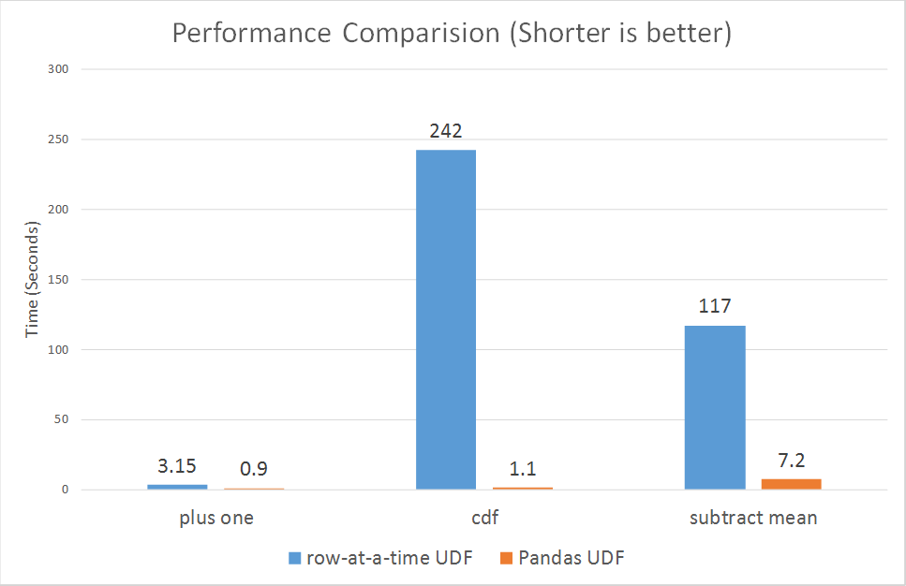
Pandas / Vectorized UDFs

Slide 11
Comparison between T-Sql and Pyspark
T-SQL | Pyspark
Function | UDF
Index | Typically not needed but bloom filter indexes are available
Schema | No concept of schema. Database is the only entity
CTAS (Create Table As Select) | Supports CTAS
ROLE | Table ACLs (Unity Catalog)
PARTITION RANGE|LEFT|RIGHT|VALUES | Data Partitions are supported
Column level Constraints | Constraints are supported. DLT also supports Data Quality around constraints
DISTRIBUTION = HASH/Round-robin,.. | Not needed. Delta is already optimised
Cursors | Not needed, but technically it is possible to loop through a dataframe
CTE (Common Table Expressions) and recursive CTE | CTEs are supported but not recursive CTEs
Note: Be aware of Datatype conversions. For example spark supports only string and not datatypes like varchar, nvarchar, etc.

Slide 12
Delta Live Tables

Slide 13
Declarative ETL pipelines with Delta Live Tables
Source
/* Create a temp view on the accounts table */
CREATE INCREMENTAL LIVE VIEW account_raw AS
SELECT * FROM cloud_files(“/data”, “csv”);
Use intent-driven declarative development to abstract away the “how” and define “what” to solve
Automatically create high-quality lineage and manage table dependencies across the data pipeline
Automatically checks for errors, missing dependencies and syntax errors, and manage pipeline recovery
Bronze
/* Stage 1: Bronze Table drop invalid rows */
CREATE INCREMENTAL LIVE TABLE account_bronze AS
COMMENT "Bronze table with valid account ids"
SELECT * FROM fire_account_raw ...
Silver
/* Stage 2:Send rows to Silver, run validation rules */
CREATE INCREMENTAL LIVE TABLE account_silver AS
COMMENT "Silver Accounts table with validation checks"
SELECT * FROM fire_account_bronze ...
Gold
Notes:
While the Auto-Loader makes it easy to get data into Delta Lake,
data engineers still spend most of their time defining and writing code to manage the ETL lifecycle-- handling table dependencies, recovery, backfilling, retries or error conditions, when what they really want is to spend more time writing transformation and applying the business logic. This turns what could be a simple ETL process into a complex data pipeline implementation.
That’s why we developed Delta Live Tables. DLT is a Managed Service for ETL. Instead of low-level hand-coding of ETL logic, data engineers can leverage SQL or Python to build declarative pipelines – easily defining ‘what’ to do, not ‘how’ to do it.
With DLT, they specify how to transform and apply business logic, while DLT automatically manages all the dependencies within the pipeline. This ensures all tables are populated correctly, continuously or on a set schedule.
DLT also offer both Python and SQL APIs for Delta Live Tables. And this is particularly valuable to SQL users, because they can now start building incremental streaming pipelines, purely in SQL, while still having access to a Python and data engineering interface, where you can pull in more complex libraries and take advantage of the complexity that Python offers.
We hope that this will allow our customers to start more aggressively taking advantage of incremental processing and designing their architectures with a streaming first view.
--------
While the Auto-Loader makes it easy to get data into Delta Lake, data engineers still spend most of their time defining and writing code to manage the ETL lifecycle-- handling table dependencies, recovery, backfilling, retries or error conditions, when what they really want is to spend more time writing transformation and applying the business logic. This turns what could be a simple ETL process into a complex data pipeline implementation.
That’s why we developed Delta Live Tables. DLT is a Managed Service for ETL. Instead of low-level hand-coding of ETL logic, data engineers can leverage SQL or Python to build declarative pipelines – easily defining ‘what’ to do, not ‘how’ to do it. With DLT, they specify how to transform and apply business logic, while DLT automatically manages all the dependencies within the pipeline. This ensures all tables are populated correctly, continuously or on a set schedule.
DLT also offer both Python and SQL APIs for Delta Live Tables. And this is particularly valuable to SQL users, because they can now start building incremental streaming pipelines, purely in SQL, while still having access to a Python and data engineering interface, where you can pull in more complex libraries and take advantage of the complexity that Python offers. We hope that this will allow our customers to start more aggressively taking advantage of incremental processing and designing their architectures with a streaming first view.

Slide 14
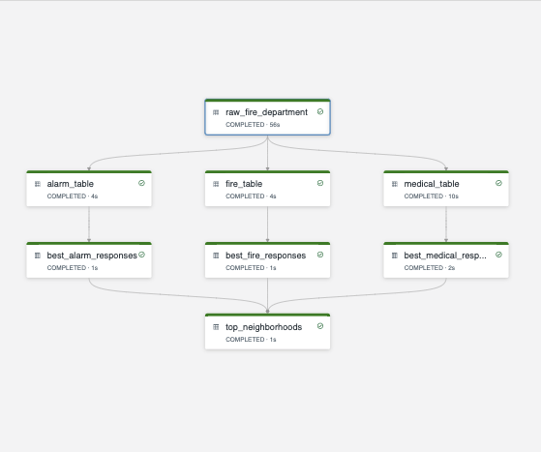
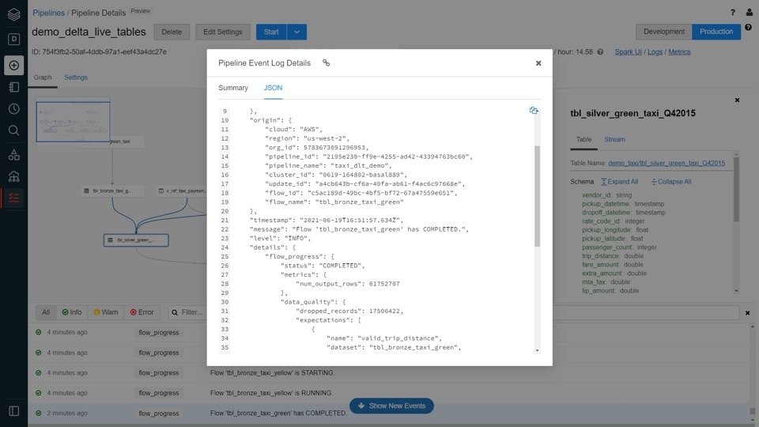
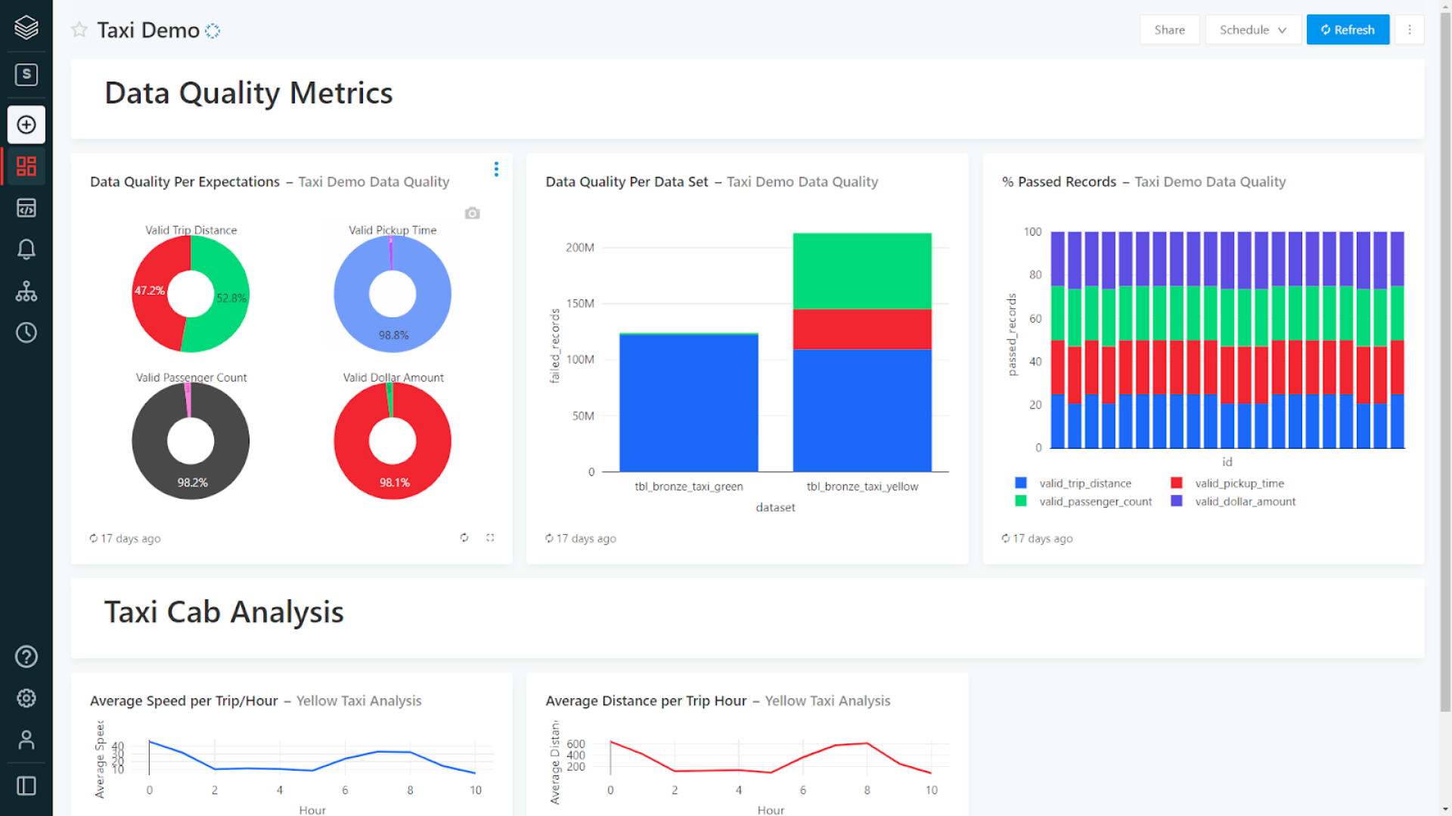
Data pipeline observability in Delta Lives Table
High-quality, high-fidelity lineage diagram that provides visibility into how data flows for impact analysis
Granular logging for operational, governance, quality and status of the data pipeline at a row level
Continuously monitor data pipeline jobs to ensure continued operation
Email alerting using Databricks SQL
Notes:
In addition to providing tools to track and enforce data quality at the table level, Delta Live Tables provides powerful pipeline observability
so you get a high-fidelity lineage diagram of your pipeline, track dependencies, and aggregate data quality metrics across all of your pipelines.
DLT emits all pipeline logs to a predefined Delta Lake table in the pipeline’s Storage Location, which can be used for monitoring, lineage, and data quality reporting. Because DLT logs are exposed as a Delta table, and the log contains data expectation metrics, it is easy to generate reports to monitor data quality with your BI tool of choice.
For example you can calculate metrics on the percentage of failures, number of rows processed, and more.
In addition to metrics, the logs include information to manage data governance including 1/ logging of all the operations in the pipeline and 2/ dependencies between pipelines and tables.
To query and visualize the event log, we recommend using Databricks SQL as it is tightly integrated with Delta and the Databricks platform and provides extremely fast query speeds via easy to manage compute endpoints.
You can also set up simple email alerts on data quality metrics with Databricks SQL -- for example you can be alerted when the % of failed rows in a particular table exceeds a use-defined threshold. Over time we will enhance ways to notify you of issues and also integrate with your favorite operational monitoring tools.
---------
In addition to providing tools to track and enforce data quality at the table level, Delta Live Tables provides powerful pipeline observability so you get a high-fidelity lineage diagram of your pipeline, track dependencies, and aggregate data quality metrics across all of your pipelines.
To make this work: DLT emits all pipeline logs to a predefined Delta Lake table in the pipeline’s Storage Location, which can be used for monitoring, lineage, and data quality reporting. Because DLT logs are exposed as a Delta table, and the log contains data expectation metrics, it is easy to generate reports to monitor data quality with your BI tool of choice. For example you can calculate metrics on the percentage of failures, number of rows processed, and more. In addition to metrics, the logs include information to manage data governance including 1/ logging of all the operations in the pipeline and 2/ dependencies between pipelines and tables.
To query and visualize the event log, we recommend using Databricks SQL as it is tightly integrated with Delta and the Databricks platform and provides extremely fast query speeds via easy to manage compute endpoints. With Databricks SQL, you can also set up simple email alerts on data quality metrics, so for example you can be alerted when the % of failed rows in a particular table exceeds a use-defined threshold. Over time we will certainly build in better ways to notify you of issues and also integrate with your favorite operational monitoring tools.

Slide 15
Bring your Own Use Case

Slide 16
Transpiler Approach (FAQs)
Is it possible to convert 100% of T-sql code to pyspark code using a transpiler automatically?
No. Typically it is anywhere around 80% to 95%
Does using the transpiler approach reduce development time?
Yes. Typically it can reduce upto 75% of development efforts
Is there any solution that databricks provide?
Databricks has got partnership with Technology partners and SI partner for implementing such solutions. Please get in touch with us for more details
Can we build a transpiler internally for this purpose?
Definitely. It is easy build a simple transpiler that would still considerably reduce development efforts
When to go for transpiler approach?
When you have 1000s of scripts to convert from T-Sql to Pyspark. A Few hundred can be easily and efficiently converted by a small team of developers in a few weeks
Are there any gotchas of using transpilers?
Even though transpilers provide a quick migration pathway, the conversion might not be efficient everytime. For example, when processing hierarchical data

Slide 17
Best Practices
Do not try to convert the T-SQL line by line as most of the times, a complex functionality written in T-SQL could be achieved with a single pre-defined or user defined function
Be cautious of the Datatype difference between T-SQL and spark
Whenever possible, try to write modular, scalable code that can be easily extended
Any transpiler might not convert 100% of the code. Hence always investigate the final code and test it as much as possible
Stick to all best practices mentioned for Delta
Notes:
The size of your table is definitely a factor for setting your table properties for optimum performance
If your table is append-only, then it might require minimum optimisation as most of the optimization will be aimed at improving the read performance of your tables
If your table involves merge, the write performance of your table will be severely impacted. Hence having the optimum configuration/table properties is critical for getting the best performance
Frequency of the table being refreshed is also vital and influences strategy around performance optimization
Selecting the best partition column is also very critical. It is better not to select a partition column than to select a wrong partition column
Long tables (with hundreds of columns) also impacts performance. Setting too small max size for target file or optimize will result in tiny files problem.

Slide 18
Thank you

